Slide 1
Government funding options
for growers in the kiwifruit industry
As at June 2021

Slide 2
Ministry For Primary Industries (MPI)
MPI has different schemes and on-going projects set up to help provide support to those in primary industries, including horticulture. These slides have been put together to provide information to individuals and groups in the kiwifruit industry on the many different options available to them through MPI.
These options include:
Support and mediation for financial problems
Environment and sustainability schemes
Māori landowners and trusts support
Wellbeing in Rural communities
Project development
All information has been collected from the MPI funding and rural support website www.mpi.govt.nz/funding-rural-support/
There are several other funded programmes under MPI and MfE that have closed or are in the process of being reassessed

Slide 3
Environmental schemes
Productive & Sustainable Land use (PSLU): This package from MPI is to help landowners, businesses, and Māori decide the best way to boost productivity on their farm and improve the health of the environment. For growers, this means access to advice and support from professional farm advisers, help to support on-farm changes, and information about other land uses. For more information contact pslu@mpi.org.nz or visit https://www.mpi.govt.nz/funding-rural-support/farming-funds-and-programmes/productive-and-sustainable-land-use/
Hill Country Erosion (HCE) programme: This programme is to provide funding support for erosion-control projects run by regional councils. Through these projects, councils can help landowners stabilise erosion prone land – such as banks near waterways – with tools like tree planting or fencing. For more information contact forestgrants@mpi.govt.nz or visit https://www.mpi.govt.nz/forestry/funding-tree-planting-research/hill-country-erosion-programme/

Slide 4
Māori landowners' support
MPI has two current programmes available for Māori landowners and trusts to provide support in Agribusiness:
MAPIP (Māori Agribusiness pathway): This programme provides support for trustees and owners of whenua Māori who want to change their land use. MAPIP focuses on tangible on-the-ground projects. These projects lead to increasing the productivity and sustainability use of whenua
MABx (Māori Agribusiness extension): This programme was put together to help Māori landowners and trusts make connections with other like-minded groups to help develop their ideas through these connections.
For more information on either of these programmes contact maoriagribusiness@mpi.govt.nz or visit https://www.mpi.govt.nz/funding-rural-support/maori-agribusiness-funding-support/
More information on other government funded programmes for Maori landowners can be found at Te Puna Kokiri https://www.tupu.nz/en/kokiri/applying-for-funding-or-investment/search-for-funding-opportunities

Slide 5
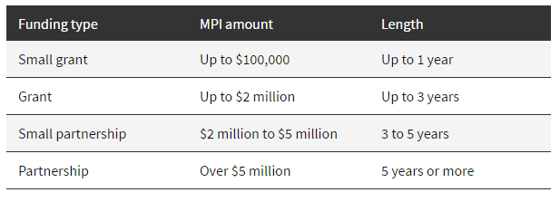
Sustainable Food and Fibre Futures (SFFF)
SFFF can provide support at any level on a co-investment basis from small grassroots community projects to large-scale industry development. This can include:
The development of a new product or service, or a better way of doing something
Feasibility studies, such as exploring the development of a solution to an industry issue, or the viability of a new product
Applied research which has a practical application and addresses a real issue in the industry or helps pursue an opportunity.
For more information on the SFFF programme contact sff.futures@mpi.govt.nz or visit https://www.mpi.govt.nz/funding-rural-support/sustainable-food-fibre-futures/

Slide 6
Mental wellbeing fund for rural communities
This fund has been set up by MPI to provide financial support to organisations in rural communities wanting funding for projects and services that add support for people in their community with unmet or high wellbeing needs like:
Support groups that provide one on one peer support
Expanded services to isolated rural communities
For more information or to put an idea for a project forward, contact the rural communities' email ruralcommunities@mpi.govt.nz or visit https://www.mpi.govt.nz/funding-rural-support/mental-wellbeing-fund-for-rural-communities/

Slide 7
Farm debt mediation scheme
This MPI provided service has been put together to help farmers or growers facing financial problems get advice and help with looking at solutions. The service also provides mediation between the farmers and creditors. The types of loans that can be discussed are:
Loans secured against farmland & farm machinery
Loans secured against harvested crops
For more information see the MPI website or contact the email farmdebtmediation@mpi.govt.nz or visit https://www.mpi.govt.nz/funding-rural-support/farming-funds-and-programmes/the-farm-debt-mediation-scheme-2/

